Slide 1
PowerShell Developer Study Group
Neil du Plessis | Cloud Solutions/Security Architect | BUI
CISSP | Microsoft Security Expert | Power BI Data Analyst | MCT

Slide 2

Agenda
Welcome to study group
Objectives and modules
Study materials
Challenges
Next steps

Slide 3
Welcome to Study Group
Not a course

Slide 4

Not a course
The facilitator is also learning 😉
Individual preparation and take turns to present a module
Sessions
Intro session (today)
Study group sessions
Capstone sessions
Two sessions per week, 16:00 to 18:00

Slide 5
Study group sessions
Before
During
Course materials and additional research
Take turns presenting your tutorial
Complete the challenge
Q&A
Create a tutorial (if it’s your turn)
Confirm and schedule next session

Slide 6
What is a Tutorial?
Instructions
Code
Also…
Concise, practical explanations
Practical step-by-step instructions
Structured
Code samples
Should be in markdown format
Can be published to GitHub
Instead of copy/paste from the tutorial text, have the code prepared
Alternatively, the tutorial text is built into the code as comments (you obviously don’t get to use markdown formatting in this case)
Can be published to GitHub
Don’t default to PowerPoint (but there are exceptions)
Remember: you can do your own thing
Turn the challenge into a tutorial
Don’t just copy/paste the courseware – try your own thing or at least some variation

Slide 7
Do your part
Yes 🙆‍♂️
Everyone prepare
No! 🙅
Parroting
Do additional research
Run ahead
Use AI
Demo-heavy
Do your own thing
Skip sessions
Use code you don’t understand
Use customer or BUI environments
PPT heavy

Slide 8
Objectives and Modules
What we’ll be doing

Slide 9
Objectives
Confidently add PowerShell to your skills on LinkedIn
Overcome any fear of dreaded PowerShell exam questions
Cast spells on IT objects that no GUI can achieve
Start a portfolio of code building blocks for future use or CV buff
Raise a golem to do repetitive tasks for you
Have a ton of fun learning something new
What do you want out of this experience?

Slide 10
Modules
1. Intro to PS
What PowerShell is and some history
2. Development Environment
PowerShell Core
4. Object Model
Pipeline
6. Scripts and functions
PowerShell development projects
7. Cloud Management
8. Capstone project
Cmd vs. WPS vs. PS
Learn and use PowerShell with just 3 commands
Use PowerShell for cloud
Putting it all together
3. Source Control
Getting started with Git and GitHub
Windows Terminal
Visual Studio Code
Logic
Input/Output
Error handling
Variables
5. Input / Output
Objects

Slide 11
Study Materials
So, where’s the manual?

Slide 12
Study Materials
YouTube
Microsoft Learn
Other
Learn PowerShell – YouTube
Computer Stuff They Didn't Teach You – YouTube
Windows Terminal – YouTube
Optimizing Visual Studio Code for Powershell Development by Justin Grote – YouTube
Introduction - PowerShell | Microsoft Learn
PowerShell learning paths and modules - Training | Microsoft Learn
Manage source control - Training | Microsoft Learn
Hello World - GitHub Docs
skills/introduction-to-github: Get started using GitHub in less than an hour.
Google

Slide 13
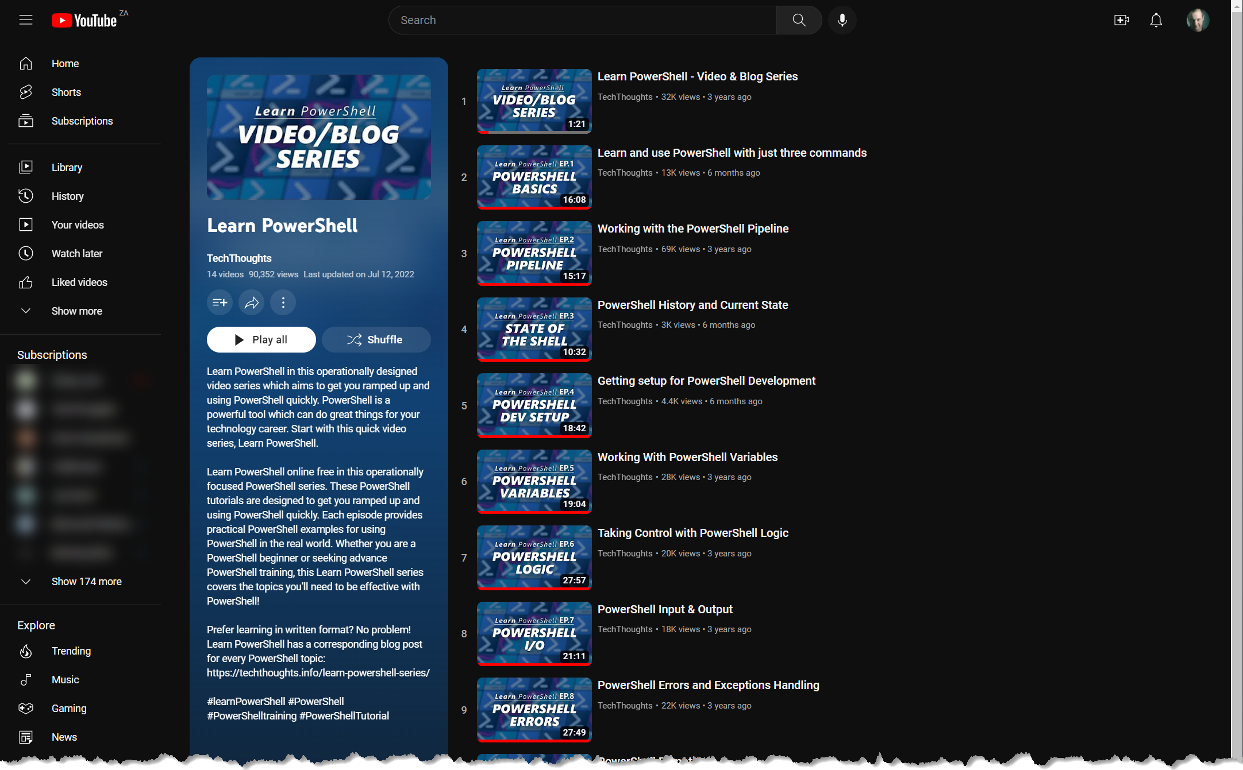
Learn PowerShell – TechThoughts

Slide 14
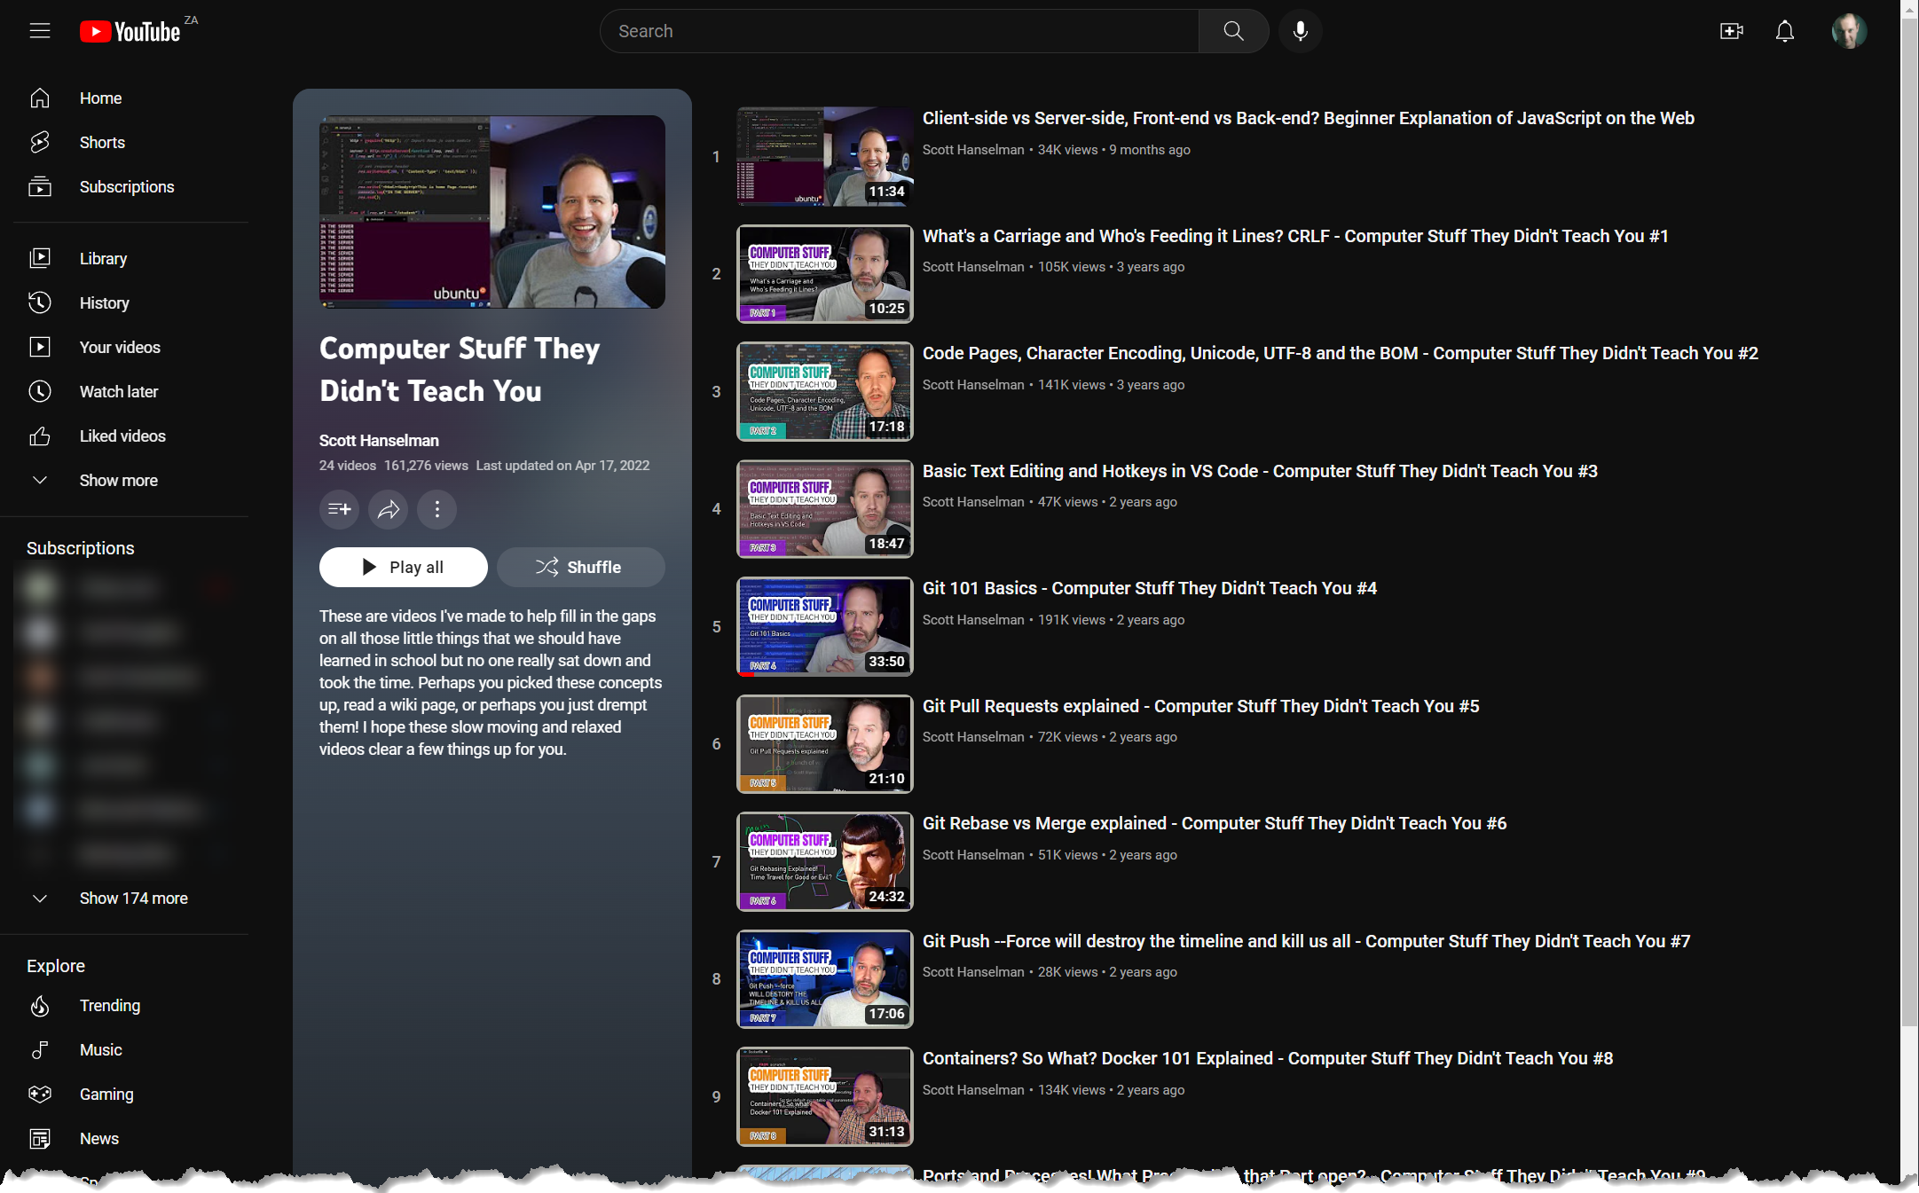
Computer Stuff… - Scott Hanselman

Slide 15
Next Steps
Where to from here?

Slide 16

Next Steps
Who wants to present first?
GitHub Repo: https://github.com/powerneil/2023-01-ps-dev-study-group
Don’t fork or clone the repo yet – we’ll get to that in module 3

Slide 17




Thank you
Neil du Plessis | Cloud Solutions/Security Architect | BUI
CISSP | Microsoft Security Expert | Power BI Data Analyst | MCT

